Slide 1
Pizza Sales Dashboard Analysis

Slide 2
Objective
To analyze pizza sales performance and identify key insights from the dashboard.

Slide 3
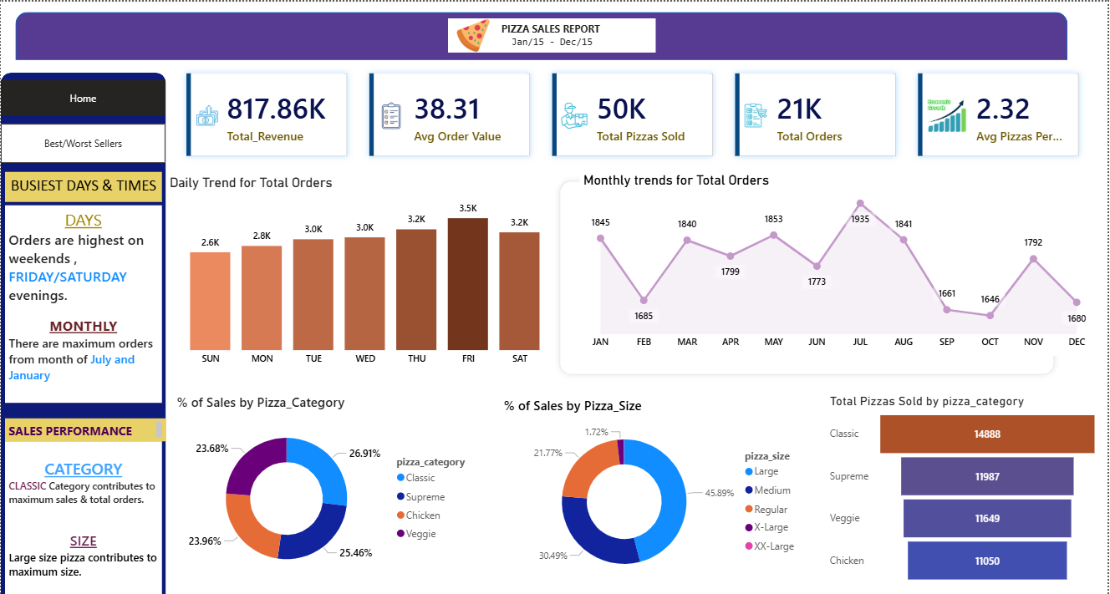
Home Page-

Slide 4
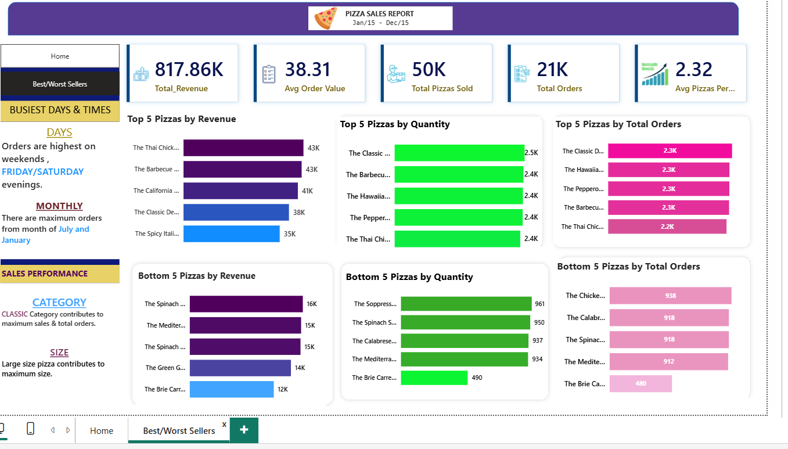
This is the second page named as Best/Worst Sellers

Slide 5
Key KPI’s (Key Performance Indicators)
Total Revenue – Total money earned from all pizza sales.
Total Orders – Total number of orders placed by customers.
Total Pizzas Sold – Total number of pizza sold according to category, size, quantity etc.
Avg Order Value – Average amount spent by customer per order.
Avg Pizzas per Order – Average number of pizzas sold per order.

Slide 6
Sales Trends
Highest sales on FRIDAY & SATURDAY evenings.
Seasonal peaks in the month of JULY & JANUARY.

Slide 7
Category & Size Insights
“CLASSIC” Category contributes the highest sales.
LARGE size pizzas are most preferred by the customer.

Slide 8
Top Selling Pizzas
Thai
Chicken
Barbeque
These drive major revenue from all the others pizza category.

Slide 9
Low Performing Pizzas
Brie Carre
Spinach
These products need improvement or removal.

Slide 10
Key Insights
Customer prefer group orders.
Weekend demand is high.
Seasonal trends exists.
Large size preferred.
CLASSIC pizza dominate.

Slide 11
Conclusion
Overall the analysis shows strong demand during weekends, clear customer preferences and some seasonal variations in sales.
It helps in making better business decisions and improve overall sales performance.

